Slide 1
Migration of Invasive Aquatic Species in MN
April 20th
2023
Presented by:
Arunkumar Sridharan
Jack Lowry
John Muir
Sunita Kumari

Slide 2
Minnesota is home to over 11,000 lakes, over 6,500 rivers, and over 10 million acres of wetlands. Water is in our DNA, but unfortunately, invasive species are in our waters.
Minnesota hosts 18 recognized invasive aquatic animals, 10 aquatic plants, and 10 aquatic diseases. Many of them arrived in the state through infested watercraft or traveling through connected waterways such as the Mississippi or the Great Lakes

Slide 3
Data and Delivery
MongoDB, Flask API, JavaScript, HTML/CSS
We captured our data from the MN DNR website: https://www.dnr.state.mn.us/invasives/ais/infested.html
Input the data into a MongoDB database
Extracted the data from the database using a python powered Flask API
Used HTML/CSS to create the webpage
Line Chart: Shows how many lakes are infested
Map: GJSON marker cluster with pop ups and more detail
Bar Chart: How much the species has spread

Slide 4
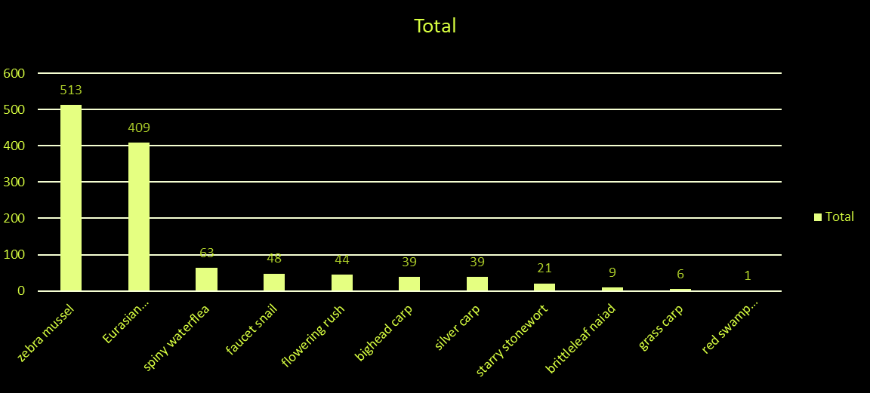
Dominant Species Found

Slide 5
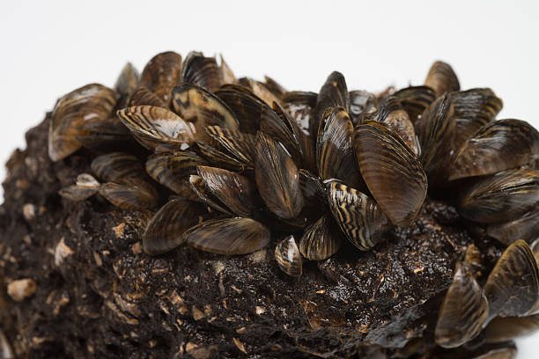
Aquatic Invasive Species
Zebra Mussel is leading the list followed by Eurasian watermilfoil
•. The species was unintentionally introduced into the United States’ Great Lakes through the discharge of contaminated cargo ship ballast water. They were first discovered in the Great Lakes in 1988 and were first confirmed in the Duluth/Superior Harbor in 1989.
•Zebra mussel impacts: Encrust equipment, such as boat motors and hulls, which reduces performance and efficiency and is costly to clean and repair.

Slide 6
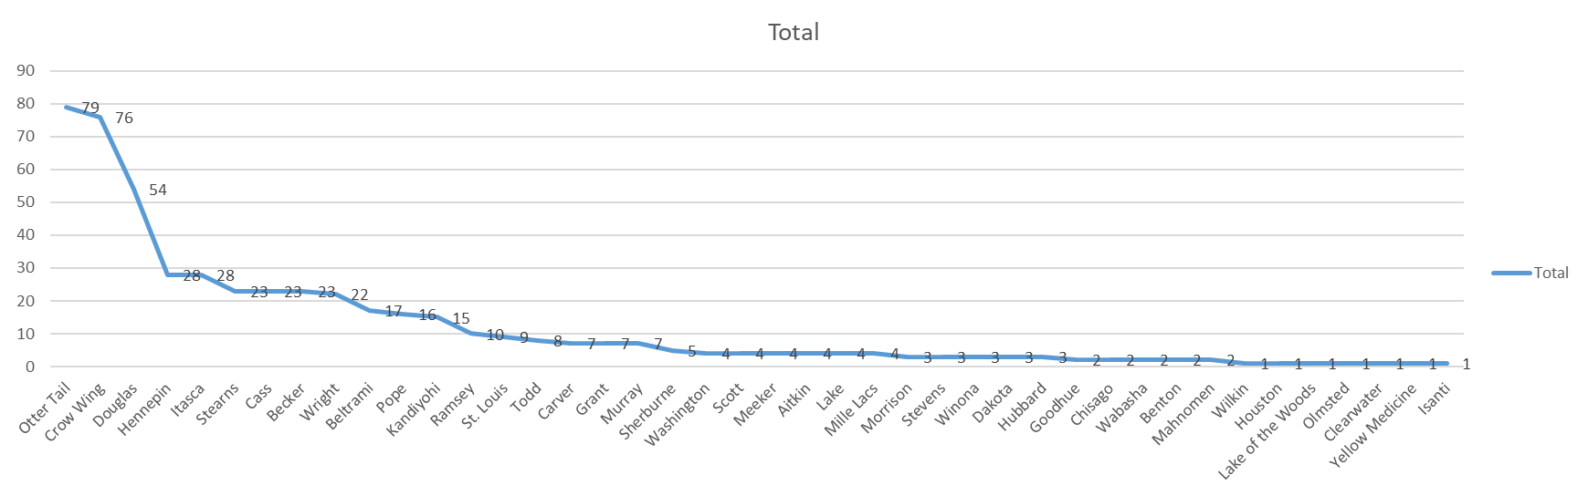
County Wide Numbers

Slide 7
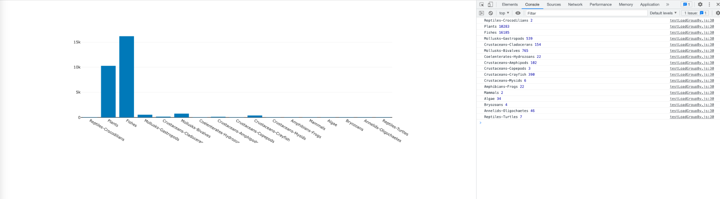
Work in Progress…
Data source: https://nas.er.usgs.gov/queries/SpeciesAnimatedMap.aspx
Notes:
Dominant Groups: Fishes > Plants > Mollusks Gastropods > Crayfish > Mollusks-Cladocerans Least : Reptiles Crocodilians

Slide 8
Dominant Groups: Fishes > Plants > Mollusks Gastropods > Crayfish > Mollusks-Cladocerans
Least : Reptiles Crocodilians

Slide 9
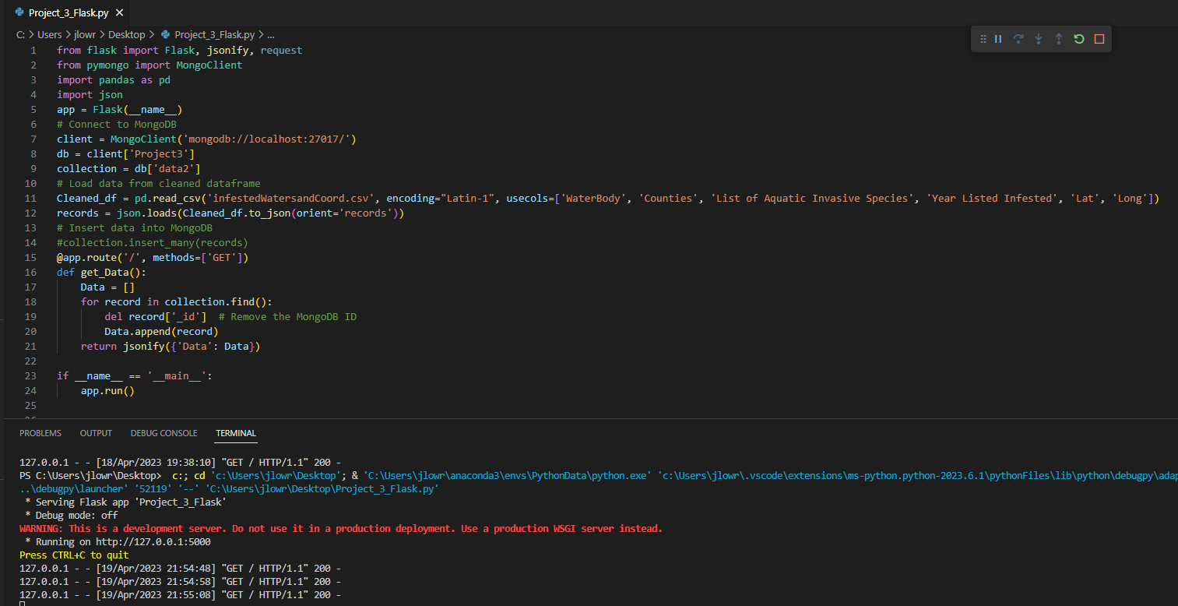
Flask API

Slide 10
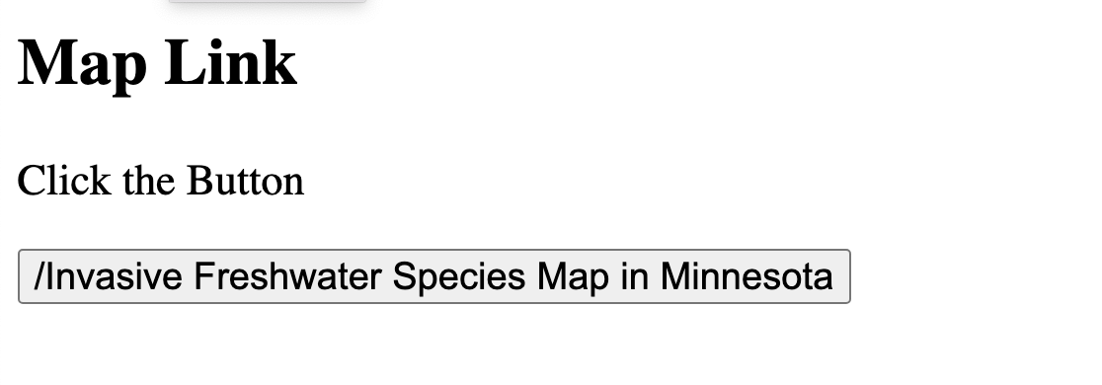
Map: Geojson Marker cluster

Slide 11
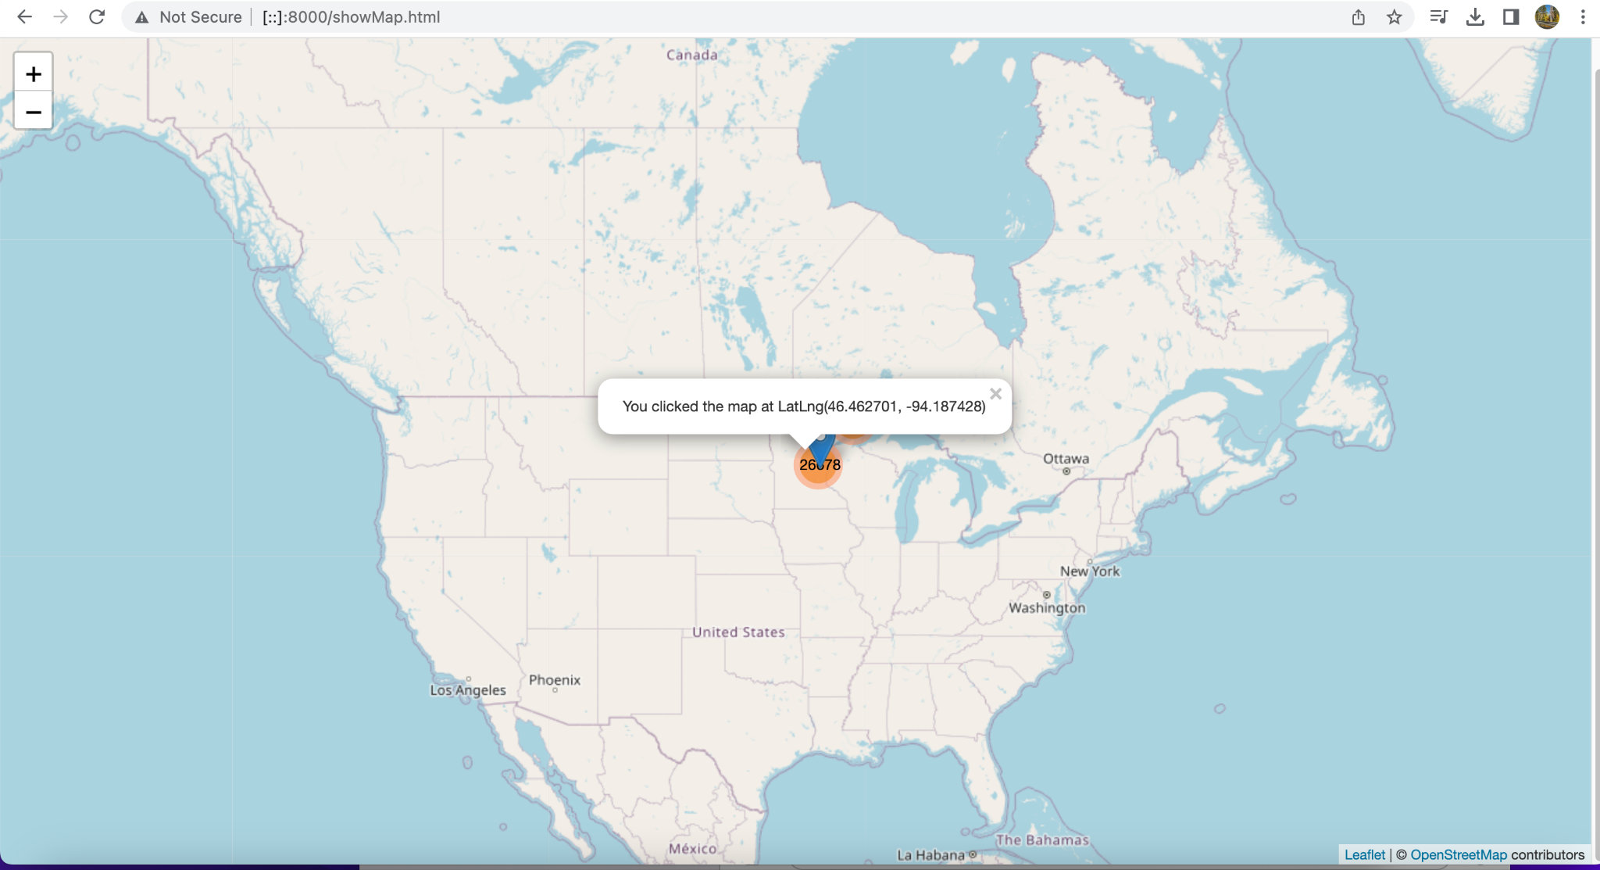
Map: Geojson Marker cluster
Minnesota, USA
Given Latitude and longitude coordinates are: 46.392410, -94.636230.
Data source: https://nas.er.usgs.gov/queries/SpeciesAnimatedMap.aspx

Slide 12
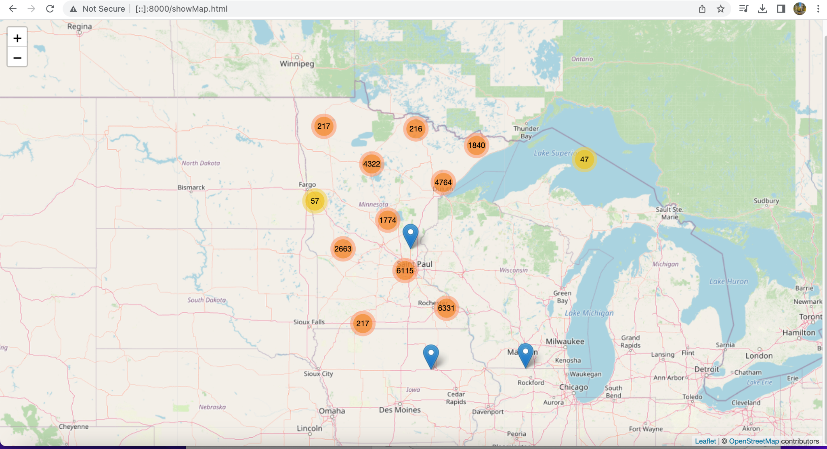
Map: Geojson Marker cluster
Data source: https://nas.er.usgs.gov/queries/SpeciesAnimatedMap.aspx

Slide 13
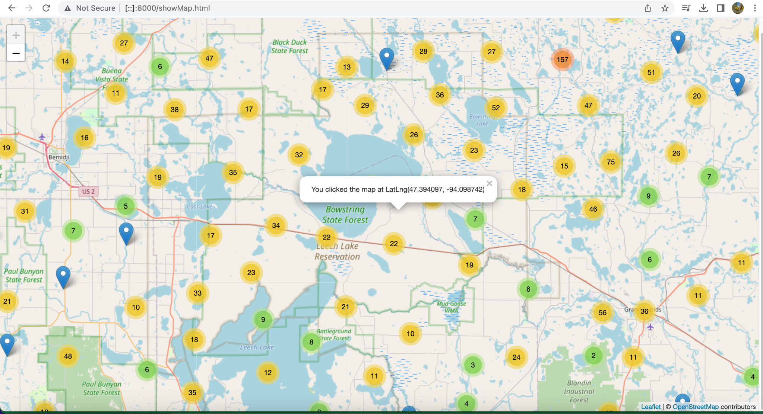
Map: Geojson Marker cluster
Data source: https://nas.er.usgs.gov/queries/SpeciesAnimatedMap.aspx

Slide 14
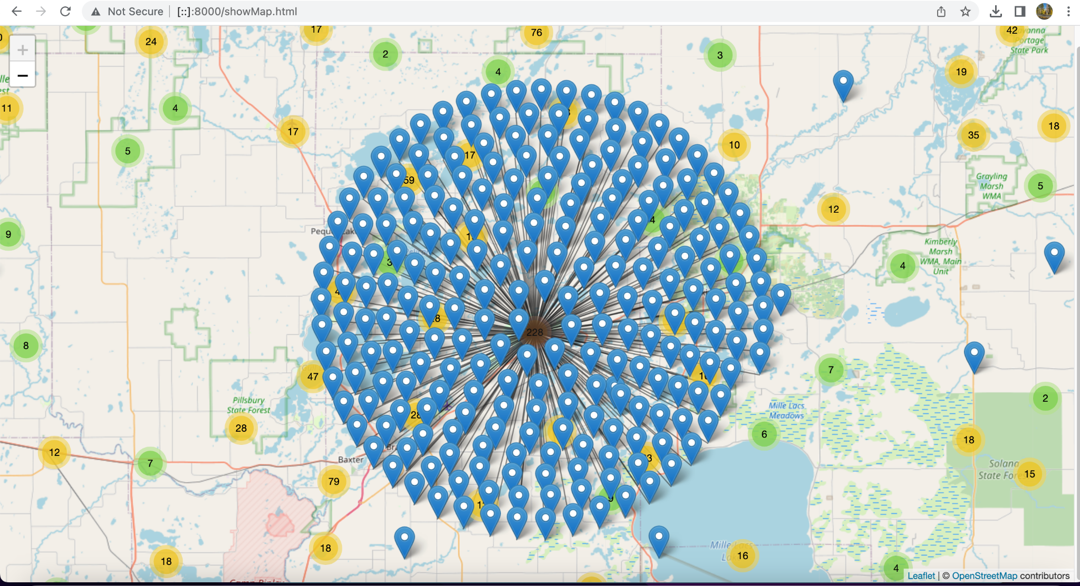
Map: Geojson Marker cluster
ttp://[::]:8000/showMap.htmlp.html
Data source: https://nas.er.usgs.gov/queries/SpeciesAnimatedMap.aspx

Slide 15
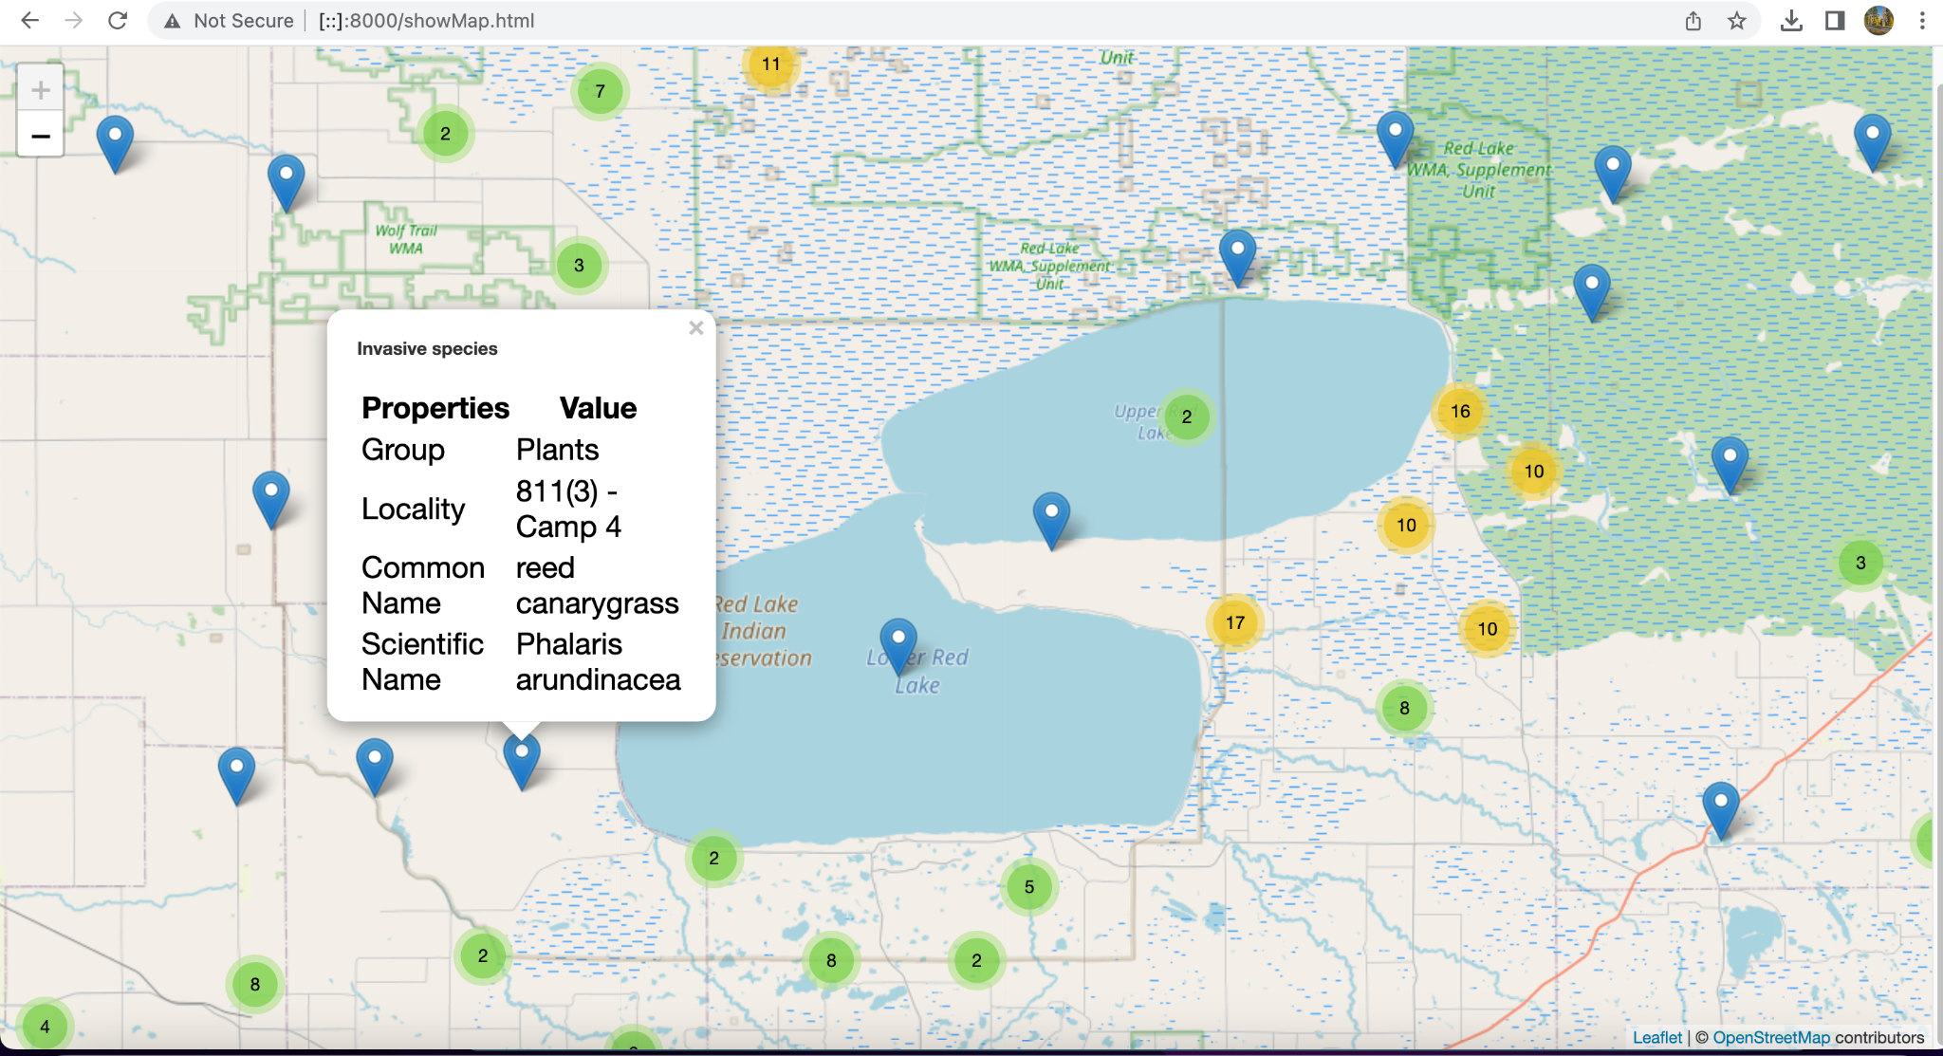
Map: Geojson Marker cluster
Data source: https://nas.er.usgs.gov/queries/SpeciesAnimatedMap.aspx

Slide 16
Conclusions
Dominant Groups By Type: Fishes > Plants > Mollusks Gastropods > Crayfish > Mollusks-Cladocerans
Least found: Reptiles Crocodilians
Top Invasive Species:
#1 Zebra Mussels
#2 Eurasian Millfoil
Heavier Population Densities Do not equate to more Invasive Species Numbers
#1 OtterTail County - 60k - 79 Invasive Species Present
#2 Crow Wing - 66k - 76 Invasive Species Present
#3 Douglas - 39k - 54 Invasive Species Present
# Hennepin - 1.28 Million - 28 invasive Species Present

Slide 17
References
https://nas.er.usgs.gov/queries/SpeciesAnimatedMap.aspx
https://leaflet-extras.github.io/leaflet-providers/preview/
https://github.com/iamtekson/Leaflet-Basic/tree/master/marker-cluster
https://github.com/Leaflet/Leaflet.markercluster
https://github.com/Mappy/Leaflet-active-area/blob/master/examples/index.html
https://www.dnr.state.mn.us/lakefind/showreport.html?downum=21024200
https://www.w3schools.com
U.S. Census Bureau QuickFacts: Hennepin County, Minnesota

Slide 18
We would like to acknowledge the below for their help with content and coding:
Charla Garcia Stack Overflow EdX Lessons
Jason Leppelmeier MN Dept of Natural Resources ChatGPT
Saad Khan Edx Homework Family

Slide 19
THANK YOU!
Questions?

